Slide 1

Stock Price Prediction using Machine Learning

Slide 2
Introduction
What is stock price prediction?
Traditional methods vs. machine learning
How machine learning is used for stock price prediction
Benefits and limitations of machine learning for stock price prediction

Slide 3
Introduction:
Our goal is to bridge the gap between the dynamic world of trading and the limitless potential of machine learning.
In today's world, where technology is advancing at an unprecedented pace, it has become increasingly important to use innovative tools and techniques to stay ahead in the game.
One such tool that has gained immense popularity in recent years is machine learning. By analyzing vast amounts of historical data, machine learning algorithms can identify patterns and predict future trends with remarkable accuracy. And when it comes to predicting stock prices, this technology can be a game-changer for investors looking to make informed decisions and maximize their returns.

Slide 4

What is stock price prediction? Stock price prediction is the process of using historical data and statistical analysis to forecast future movements in the price of a particular stock or group of stocks. It is a valuable tool for investors who are looking to make informed decisions about buying, selling, or holding stocks. By analyzing patterns in past market performance, stock price prediction models can identify trends and make predictions about future market behavior. This information can be used by investors to make strategic decisions about their investments, such as when to buy or sell a particular stock.

Slide 5

Traditional methods vs. machine learning
Traditional methods of stock price prediction rely on historical data and statistical analysis to make predictions. These methods typically involve looking at a company's financial statements, market trends, and other relevant information to try and predict future stock prices. While these methods can be effective, they are limited by the amount and quality of data available, as well as the assumptions made by the analysts.
Machine learning methods, on the other hand, use algorithms to analyze large amounts of data and identify patterns that can be used to make predictions. These algorithms can take into account a wide range of factors, including social media sentiment, news articles, and even weather patterns. This allows for more accurate and nuanced predictions, but also requires large amounts of data and computational power.

Slide 6
How machine learning is used for stock price prediction
Machine learning algorithms are used to predict stock prices by analyzing large amounts of data and identifying patterns and trends. These algorithms use statistical models and predictive analytics to forecast future stock prices based on historical data and market trends.
One example of machine learning being used for stock price prediction is the use of neural networks. Neural networks are a type of machine learning algorithm that can identify complex patterns in data and make predictions based on those patterns. By training a neural network on historical stock price data, it can learn to recognize patterns and make accurate predictions about future stock prices.

Slide 7
Benefits and limitations of machine learning for stock price prediction
One of the main benefits of using machine learning for stock price prediction is its ability to analyze large amounts of data quickly and accurately. Traditional methods of stock price prediction often rely on manual analysis which can be time-consuming and prone to errors. Machine learning algorithms, on the other hand, can process vast amounts of historical data and use it to identify patterns and trends that human analysts might miss.
Another benefit of using machine learning for stock price prediction is its ability to adapt to changing market conditions. Markets are complex and dynamic systems that can change rapidly in response to new information or events. Machine learning algorithms can adjust their predictions in real-time based on new data, allowing investors to make more informed decisions and react quickly to changes in the market.

Slide 8
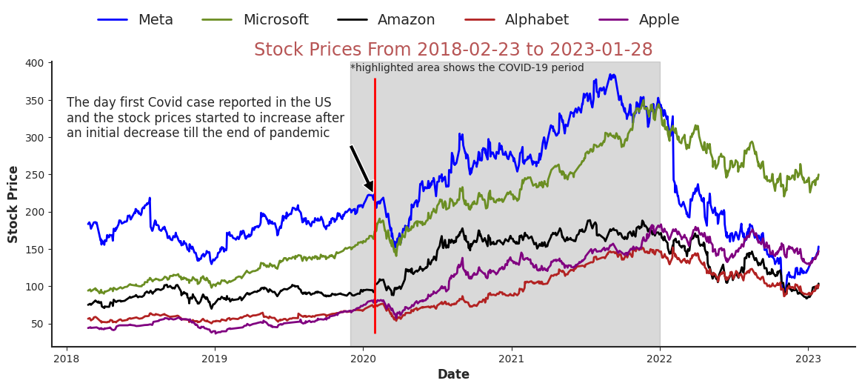
Data Preprocessing
Data Preprocessing Steps:
Handling Missing Data: Addressing missing values to ensure completeness and accuracy of the dataset.
Feature Scaling: Standardizing features to bring them to a common scale, preventing dominance by certain features.
Importance of Clean Data:
The quality of our predictions hinges on the quality of our data.
Clean, well-processed data reduces noise and enhances the model's ability to capture meaningful patterns.

Slide 9
Feature Engineering
Enhancing Feature Relevance:
Feature engineering involves selecting, transforming, and creating features to improve model performance.
We'll leverage technical indicators like moving averages, RSI, and MACD to provide deeper insights into stock price movements.
Data-Driven Insights:
Carefully crafted features can expose hidden relationships in the data that may not be apparent initially.
Feature engineering is a crucial step in translating raw data into actionable insights.

Slide 10
Model Selection
Introducing Machine Learning Models:
Machine learning models are algorithms that learn patterns from data to make predictions or decisions.
They play a pivotal role in our journey to predict stock prices.
Exploring Model Choices:
Our project involves experimenting with diverse models to uncover their strengths and limitations.
Notable models include Linear Regression, which provides a baseline, and advanced options like Neural Networks for capturing intricate patterns.
Linear Regression:
A fundamental model to establish a starting point.
Utilizes relationships between features and target to make predictions.
Neural Networks:
A sophisticated model inspired by the human brain's neural structure.
Capable of capturing complex relationships, particularly useful for time-series data like stock prices.
Random Forests (optional):
Ensemble model that combines multiple decision trees.
Robust for handling various types of data and capturing non-linear relationships.

Slide 11

Model Training
Understanding Model Training:
Training a machine learning model involves feeding it with historical data to learn patterns.
Through iterative optimization, the model adjusts its parameters to minimize prediction errors.
Tools and Libraries:
We'll leverage popular tools and libraries such as Python and Keras for building and training neural networks
These platforms provide a range of algorithms for model training and evaluation.

Slide 12
Model Evaluation
Metrics for Model Performance:
Evaluating model accuracy requires metrics like Mean Squared Error (MSE), Root Mean Squared Error (RMSE), and Mean Absolute Error (MAE).
These metrics quantify the model's predictive accuracy and provide insights into prediction quality.
Importance of Unseen Data:
Testing our model on unseen data mimics real-world scenarios.
A well-performing model should demonstrate consistent accuracy on both training and test data.

Slide 13
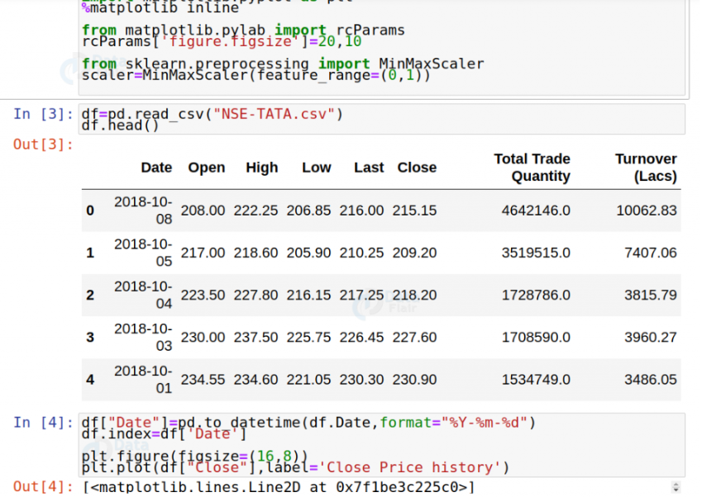
Reading the dataset:

Slide 14
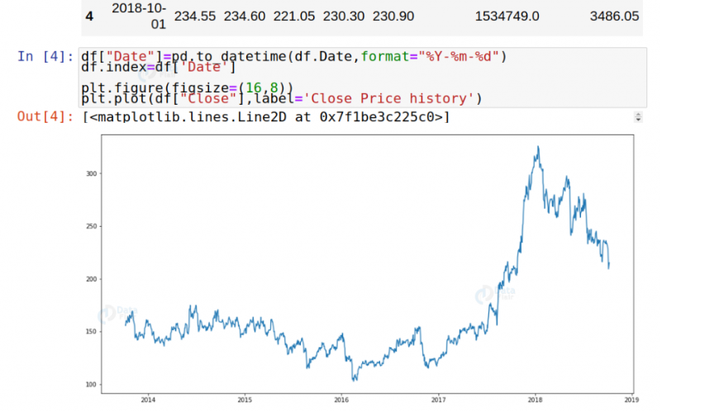
Analyzing the closing prices from dataframe:

Slide 15
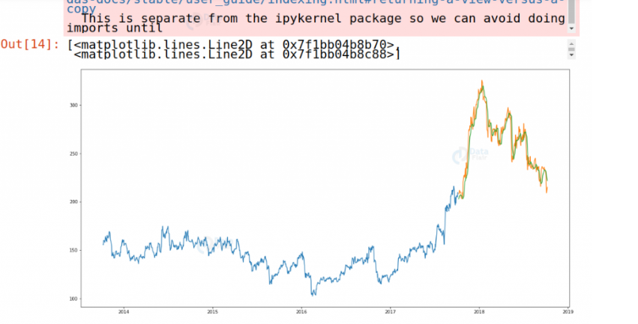
Visualizing the predicted stock costs with actual stock costs:

Slide 16
Challenges Faced
Navigating Noisy Data:
Impact of Noise on Model Accuracy:
Noise in stock price data can introduce irrelevant fluctuations, affecting prediction accuracy.
Models may struggle to distinguish true trends from noise.
Strategies for Handling Noise:
Data smoothing techniques like moving averages can help filter out noise.
Robust statistical methods and outlier removal can enhance data quality.

Slide 17
Taming Overfitting:
Understanding Overfitting:
Overfitting occurs when a model learns training data too well but fails to generalize to unseen data.
It can result in deceptive high accuracy on training data.
Mitigation Strategies:
Regularization techniques like L1 and L2 regularization can prevent model complexity.
Cross-validation helps identify the optimal model complexity that balances training and generalization.

Slide 18
Striking Model Complexity Balance:
Model Complexity and Interpretability Trade-off:
Complex models may capture intricate patterns but can be challenging to interpret.
Simple models might lack the capacity to capture subtle trends.
Our Approach:
We experimented with different model complexities, evaluating trade-offs between prediction accuracy and interpretability.
Achieved a balance by selecting a model that effectively captures essential patterns without excessive complexity.

Slide 19
Conclusion:
In conclusion, we have explored the world of stock price prediction using machine learning. We have learned what it is, how it differs from traditional methods, and how it can be used to produce accurate predictions. We have also discussed the benefits and limitations of this approach, highlighting the trade-offs involved.
It is clear that machine learning has the potential to revolutionize stock price prediction, offering investors a powerful tool for making informed decisions. However, it is important to remember that this approach is not without its limitations, and careful consideration must be given to the data and algorithms used. With that said, we encourage you to explore this topic further and discover the exciting possibilities that await in the world of stock price prediction using machine learning.

Slide 20
Links to the sources
https://github.com/alimoov/StockpricepredML

Slide 21
THANK YOU FOR YOUR ATTENTION!!!
Done by 2 students in pairs: Alimov Olimkhon
Egamberdiev Rustamjon

